Slide 1
Sudoku
Brad, Aaron, Till, Julian, and Emily

Slide 2
Final Project
Reminder
Sudoku is:
a classic puzzle game normally played with pencil and paper. This software provides a digital interface which allows users to play Sudoku, import their own Sudoku boards to play, and even create their own boards.

Slide 3
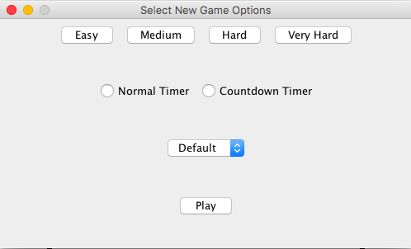
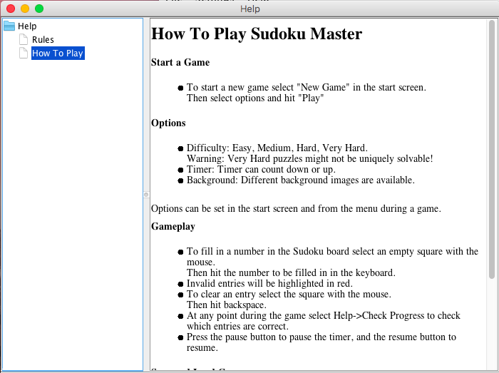
Additions
Start Page options
Help menu
Improved hints (checking user input)
Countdown timer
Improved loading

